Slide 1
Arrays 1D and 2D

Slide 2
Introduction
Arrays
  Structures of related data items
  Static entity – same size throughout the program
  Dynamic data structures

Slide 3
Arrays
Name of array (Note that all elements of this array have the same name, c)
Array
  Group of consecutive memory locations
  Same name and type
To refer to an element, specify
  Array name
  Position number
Format:
    arrayname[ position number ]
  First element at position 0
  n element array named c:
    c[ 0 ], c[ 1 ]...c[ n – 1 ]
c[0]
-45
c[1]
6
c[2]
0
c[3]
72
c[4]
1543
c[5]
-89
c[6]
0
c[7]
62
c[8]
-3
c[9]
1
c[10]
6453
c[11]
78
Position number of the element within array c

Slide 4
Arrays
Array elements are like normal variables
    c[ 0 ] = 3;
    printf( "%d", c[ 0 ] );
  Perform operations in subscript. If x equals 3
    c[ 5 - 2 ] == c[ 3 ] == c[ x ]

Slide 5
Declaring Arrays
When declaring arrays, specify
  Name
  Type of array ( data type )
  Number of elements
    arrayType arrayName[ numberOfElements ];
  Examples:
    int c[ 10 ];
    float myArray[ 3284 ];
Declaring multiple arrays of same type
  Format similar to regular variables
  Example:
    int b[ 100 ], x[ 27 ];

Slide 6
Examples Using Arrays
Initializers
    int n[ 5 ] = { 1, 2, 3, 4, 5 };
  If not enough initializers, rightmost elements become 0
      int n[ 5 ] = { 0 }
    All elements 0
  If too many a syntax error is produced syntax error
  C arrays have no bounds checking
If size omitted, initializers determine it
    int n[ ] = { 1, 2, 3, 4, 5 };
  5 initializers, therefore 5 element array
Exercise : Histogram

Slide 7
1 /* Fig. 6.8: fig06_08.c
2 Histogram printing program */
3 #include <stdio.h>
4 #define SIZE 10
1. Initialize array
2. Loop
3. Print
5
6 int main()
7 {
8 int n[ SIZE ] = { 19, 3, 15, 7, 11, 9, 13, 5, 17, 1 };
9 int i, j;
10
11 printf( "%s%13s%17s\n", "Element", "Value", "Histogram" );
12
13 for ( i = 0; i <= SIZE - 1; i++ ) {
14 printf( "%7d%13d ", i, n[ i ]) ;
15
16 for ( j = 1; j <= n[ i ]; j++ ) /* print one bar */
17 printf( "%c", '*' );
18
19 printf( "\n" );
20 }
21
22 return 0;
23 }

Slide 8
Element Value Histogram
0 19 *******************
1 3 ***
2 15 ***************
3 7 *******
4 11 ***********
5 9 *********
6 13 *************
7 5 *****
8 17 *****************
9 1 *
Program Output

Slide 9
Examples Using Arrays
Character arrays
  String “first” is really a static array of characters
  Character arrays can be initialized using string literals
      char string1[] = "first";
    Null character '\0' terminates strings
    string1 actually has 6 elements
      It is equivalent to
  char string1[] = { 'f', 'i', 'r', 's', 't', '\0' };
  Can access individual characters
    string1[ 3 ] is character ‘s’
  Array name is address of array, so & not needed for scanf
      scanf( "%s", string2 );
    Reads characters until whitespace encountered
    Can write beyond end of array, be careful

Slide 10
1 /* Fig. 6.10: fig06_10.c
2 Treating character arrays as strings */
3 #include <stdio.h>
4
1. Initialize strings
2. Print strings
2.1 Define loop
2.2 Print characters
individually
2.3 Input string
3. Print string
Program Output
5 int main()
6 {
7 char string1[ 20 ], string2[] = "string literal";
8 int i;
9
10 printf(" Enter a string: ");
11 scanf( "%s", string1 );
12 printf( "string1 is: %s\nstring2: is %s\n"
13 "string1 with spaces between characters is:\n",
14 string1, string2 );
15
16 for ( i = 0; string1[ i ] != '\0'; i++ )
17 printf( "%c ", string1[ i ] );
18
19 printf( "\n" );
20 return 0;
21 }
Enter a string: Hello there
string1 is: Hello
string2 is: string literal
string1 with spaces between characters is:
H e l l o

Slide 11
Passing Arrays to Functions
Passing arrays
  To pass an array argument to a function, specify the name of the array without any brackets
      int myArray[ 24 ];
      myFunction( myArray, 24 );
    Array size usually passed to function
  Arrays passed call-by-reference
  Name of array is address of first element
  Function knows where the array is stored
    Modifies original memory locations
Passing array elements
  Passed by call-by-value
  Pass subscripted name (i.e., myArray[ 3 ]) to function

Slide 12
1 /* Fig. 6.13: fig06_13.c
2 Passing arrays and individual array elements to functions */
3 #include <stdio.h>
4 #define SIZE 5
5
1. Function definitions
2. Pass array to a function
2.1 Pass array element to a function
3. Print
6 void modifyArray( int [], int ); /* appears strange */
7 void modifyElement( int );
8
9 int main()
10 {
11 int a[ SIZE ] = { 0, 1, 2, 3, 4 }, i;
12
13 printf( "Effects of passing entire array call "
14 "by reference:\n\nThe values of the "
15 "original array are:\n" );
16
Entire arrays passed call-by-reference, and can be modified
17 for ( i = 0; i <= SIZE - 1; i++ )
18 printf( "%3d", a[ i ] );
19
20 printf( "\n" );
21 modifyArray( a, SIZE ); /* passed call by reference */
22 printf( "The values of the modified array are:\n" );
23
24 for ( i = 0; i <= SIZE - 1; i++ )
Array elements passed call-by-value, and cannot be modified
25 printf( "%3d", a[ i ] );
26
27 printf( "\n\n\nEffects of passing array element call "
28 "by value:\n\nThe value of a[3] is %d\n", a[ 3 ] );
29 modifyElement( a[ 3 ] );
30 printf( "The value of a[ 3 ] is %d\n", a[ 3 ] );
31 return 0;
32 }

Slide 13
33
34 void modifyArray( int b[], int size )
35 {
36 int j;
3.1 Function definitions
Program Output
37
38 for ( j = 0; j <= size - 1; j++ )
39 b[ j ] *= 2;
40 }
41
42 void modifyElement( int e )
43 {
44 printf( "Value in modifyElement is %d\n", e *= 2 );
45 }
Effects of passing entire array call by reference:
The values of the original array are:
0 1 2 3 4
The values of the modified array are:
0 2 4 6 8
Effects of passing array element call by value:
The value of a[3] is 6
Value in modifyElement is 12
The value of a[3] is 6

Slide 14
Arrays
Arrays in C
  int list[5], *plist[5];
  list[5]: (five integers) list[0], list[1], list[2], list[3], list[4]
  *plist[5]: (five pointers to integers)
    plist[0], plist[1], plist[2], plist[3], plist[4]
  implementation of 1-D array
  list[0] base address = α
  list[1] α + sizeof(int)
  list[2] α + 2*sizeof(int)
  list[3] α + 3*sizeof(int)
  list[4] α + 4*sizeof(int)

Slide 15
Arrays
Arrays in C (cont’d)
  Compare int *list1 and int list2[5] in C.
  Same: list1 and list2 are pointers.
  Difference: list2 reserves five locations.
  Notations:
  list2 － a pointer to list2[0]
  (list2 + i) － a pointer to list2[i] (&list2[i])
  *(list2 + i) － list2[i]

Slide 16
int A[5]={ 5,4,6,8,9},i;
for (i=0;i<5;i++)
{
printf(“%d %d ”,*(a+i), *(i+a))
}

Slide 17
2D Array
2D array can be defined as an array of arrays.
The 2D array is organized as matrices which can be represented as the collection of rows and columns.
However, 2D arrays are created to implement a relational database look alike data structure.
It provides ease of holding bulk of data at once which can be passed to any number of functions wherever required.

Slide 18
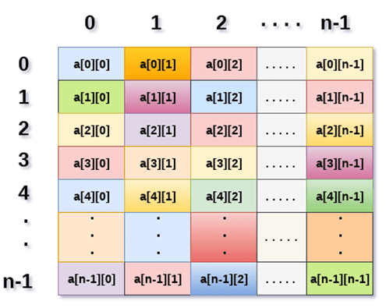
int arr[max_rows][max_columns];
however, It produces the data structure which looks like following.

Slide 19
Access 2D arrray
  we can store the value stored in any particular cell of a 2D array to some variable x by using the following syntax.
  int x = a[i][j];
Initialize
  declare and initialize the 2D array is given as follows.
  int arr[2][2] = {0,1,2,3};
#include <stdio.h>
void main ()
{
int arr[3][3],i,j;
for (i=0;i<3;i++)
{
for (j=0;j<3;j++)
{
printf("Enter a[%d][%d]: ",i,j);
scanf("%d",&arr[i][j]);
}
}
printf("\n printing the elements ....\n");
for(i=0;i<3;i++)
{
printf("\n");
for (j=0;j<3;j++)
{
printf("%d\t",arr[i][j]);
}
}
}

Slide 20

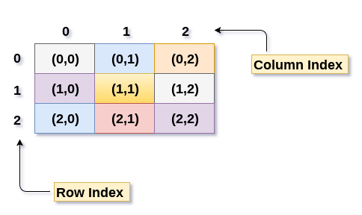
Mapping 2D array to 1D array

Slide 21
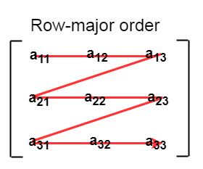

Row Major ordering
first, the 1st row of the array is stored into the memory completely, then the 2nd row of the array is stored into the memory completely and so on till the last row

Slide 22
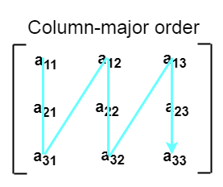

Column Major ordering
first, the 1st column of the array is stored into the memory completely, then the 2nd row of the array is stored into the memory completely and so on till the last column of the array.

Slide 23
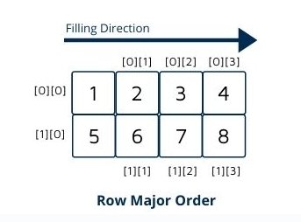
Calculating the Address of the random element of a 2D array
By Row Major Order
  If array is declared by a[m][n] where m is the number of rows while n is the number of columns, then address of an element a[i][j] of the array stored in row major order is calculated as,
  Address(a[i][j]) = BA. + ((i * n) + j) * size
  where, BA. is the base address or the address of the first element of the array a[0][0]

Slide 24
Example :
LOC (A [i, j]) = base_address + W [N * i + j]
Here,
base_address = address of the first element in the array.
W = Word size, means a number of bytes occupied by each element of an Array.
M = Number of rows in the array.
N = Number of columns in the array.
Note: Array Index starts from 0.
Suppose we want to calculate the address of element A [1, 2] and the matrix is of 2*4. It can be calculated as follow:
Here,
base_address = 1000, W= 2, M=2, N=4, i=1, j=2
LOC (A [i, j]) = base_address + W * [(N*i) + j]
LOC (A[2, 3]) = 1000 + 2 *[4*(1) + 2]
= 1000 + 2 * [4 + 2]
= 1000 + 2 * 6
= 1000 + 12
= 1012

Slide 25
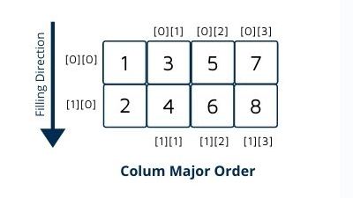

By Column major order
  If array is declared by a[m][n] where m is the number of rows while n is the number of columns, then address of an element a[i][j] of the array stored in row major order is calculated as,
  Address(a[i][j]) = BA + ((j*m)+i)*Size
  where BA is the base address of the array.
Example :

Slide 26
The Location of element A[i, j] can be obtained by evaluating expression:
LOC (A [i, j]) = base_address + W * [M * j + i]
Here,
base_address = address of the first element in the array.
W = Word size means a number of bytes occupied by each element of an Array.
M = Number of rows in the array.
N = Number of columns in the array.
Note: Array Index starts from 0.
Here we have taken a 2-D array A [2, 4] which has 2 rows and 4 columns.
Suppose we want to calculate the address of element A [1, 2] in column-major order and the matrix is 2*4. It can be calculated as follow:
Now to calculate the base address of any index using column-major order we can use the process given below.
It can be calculated as follow:
Here,
base_address = 2000, W= 2, M=2, N=4, i=1, j=2
LOC (A [i, j]) = base_address + W [M * j + i ]
LOC (A[1, 2]) = 2000 + 2 [2*2 + 1]
= 2000 + 2 * [4 + 1]
= 2000 + 2 * 5
= 2000 + 10
= 2010

Slide 27
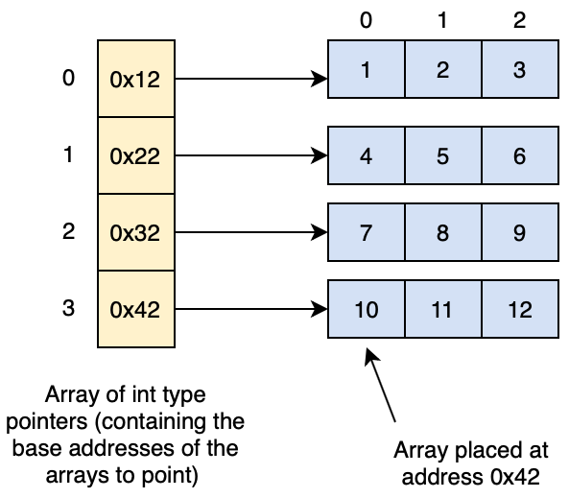

Slide 28
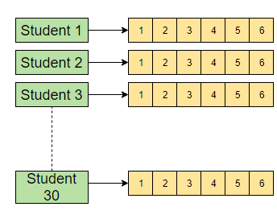
Let’s say there’s a class of 30 students, and we want to store their grades for each of their courses (six courses in total).
Is there a way we can map all this information using the knowledge we have covered so far? Yes, we can!

Slide 29
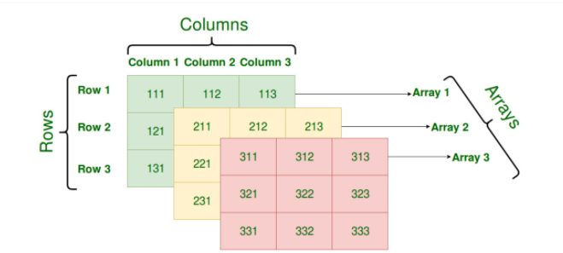
Three-Dimensional Array

Slide 30
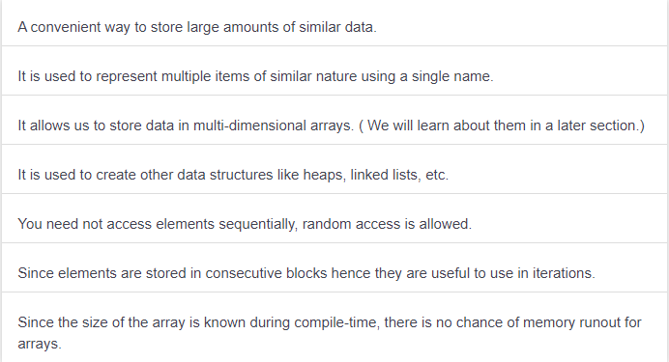
Advantages

Slide 31
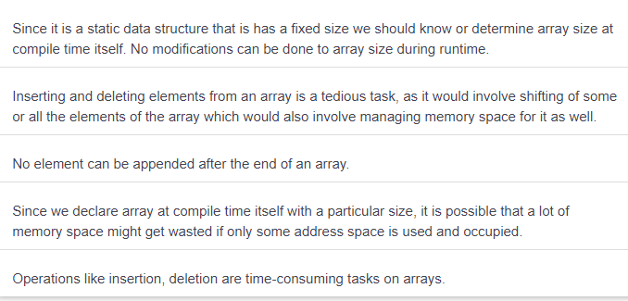
Disadvantages

Slide 32
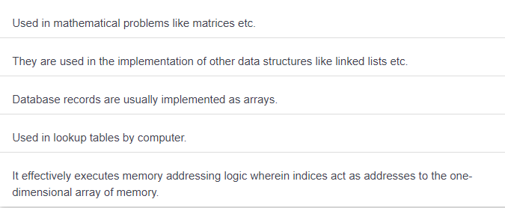
Applications of Arrays
Apart from being widely used in programming, arrays have additional applications as well:

